Slide 1
Presentation title in sentence case
Subtitle or event · Day Month Year

Slide 2
A short section title
SECTION 01

Slide 3
One message per slide
Poppins Regular 16 pt for body text; 30 pt titles in sentence case.
Deep purple #231148 for text on white or cream.
Gold is never text on a light ground; use it for rules and highlights.
Use the canonical logo files only. Never retype or redraw the lockup.
Key figure
00
State the source and date of every number.

Slide 4
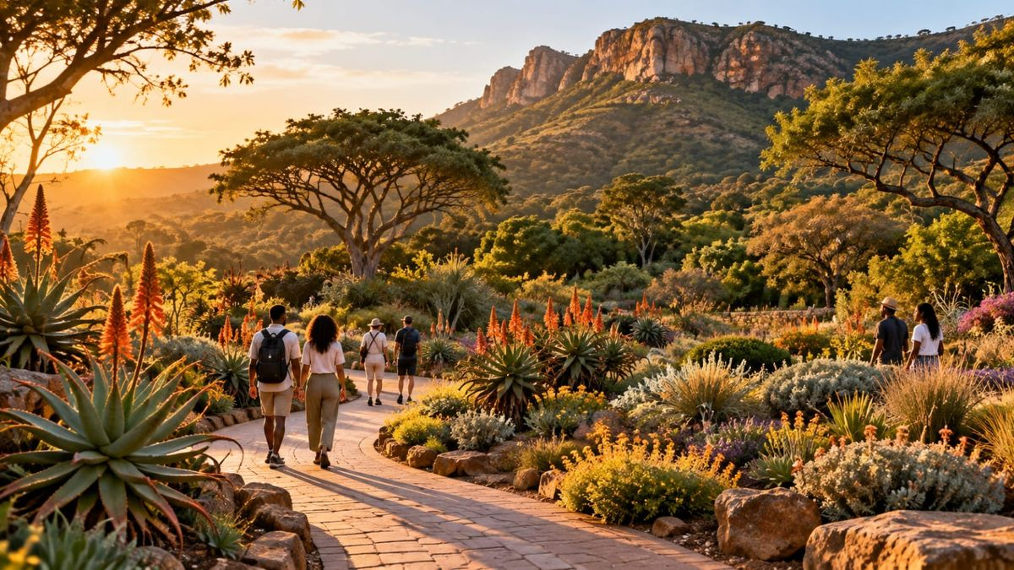
Tshwane first. Brand second.
Replace the photograph with commissioned photography of a real place. Keep the brand small on photographic slides.

